Slide 1
NEIGHBORHOOD CLUSTERS

Slide 2
technology used
IBM Watson studio
Pandas
K-Means from scikit-learn

Slide 3
Problem
Clustering the neighborhood based on a specific niche topic which is the cars (auto services) shops

Slide 4
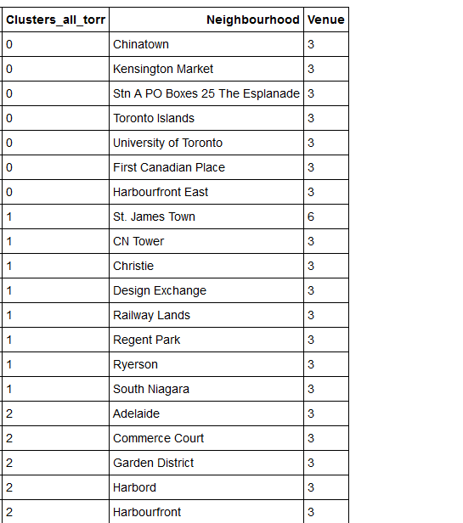
A TABLE OF CLUSTERS OF NEIGHBORHOODS HAS BEEN CREATED AS A RESULT OF THE ACTIVITY

